Slide 1
Examination of foot and Ankle
Dr. Varun.s
Dept. of. Surgery
Skhmc

Slide 2
objectivs
Assess
Diagnose
Treat

Slide 3
overview
The ankle and foot is a complex structure comprised of 28 bones (including 2 sesamoid bones) and 55 articulations (including 30 synovial joints), interconnected by ligaments and muscles
In addition to sustaining substantial forces, the foot and ankle serve to convert the rotational movements that occur with weight bearing activities into sagittal, frontal, and transverse movements

Slide 4
Anatomy
Anatomically and biomechanically, the foot is often subdivided into:
The rearfoot or hindfoot (the talus and calcaneus)
The midfoot (the navicular, cuboid and the 3 cuneiforms)
The forefoot (the 14 bones of the toes, the 5 metatarsals, and the medial and lateral sesamoids)

Slide 5
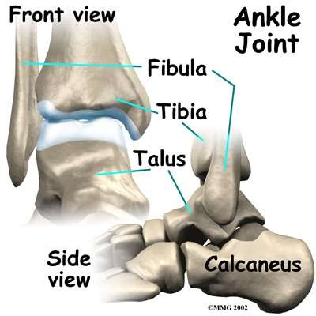
Anatomy
Ankle joint
Articulation of dome of talus in ankle mortice
Hinge joint

Slide 6
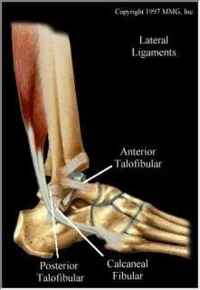
Lateral ligament complex
Lateral complex
  Ant. talofibular
  calcaneofibular
  Post. talofibular
Syndesmosis
  Ant. Inf. tibiofibular
  Post.Inf. tibiofibular

Slide 7
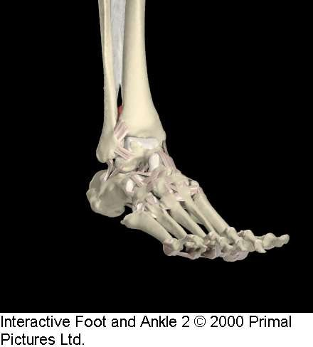
Syndesmotic Structures
Syndesmosis:
  Ant. Inf. Tibiofibular
ligament
  Post. Inf. Tibiofibular ligament
  Transverse tibiofibular
ligament
  Interosseous membrane

Slide 8
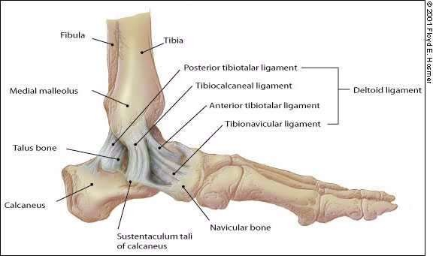
Medial Ankle Structures
Major Ligament complex is called the Deltoid Ligament.
It is the strongest of the ankle ligaments

Slide 9
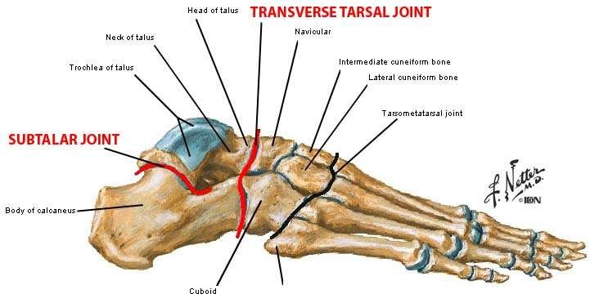
Subtalar joint
– The subtalar joint is a synovial, bicondylar compound joint consisting of two separate, modified ovoi surfaces with their own joint cavities (one male and one female)
d

Slide 10
HISTORY TAKING
Take a HISTORY
What is the patient’s chief complaint?
Pain?
  Where? When? How bad? What is it like?
  What makes it better?
  What makes it worse?
Acute Injury vs. Chronic
Progression of Symptoms?
HISTORY TAKING: Background Information
Any Previous Injuries
Past Surgical History
Past Medical History
Medications
Allergies
Social History
Work situation (laboring type job?)
Home situation

Slide 11
Examination of the foot and ankle
STEPS in the PHYSICAL EXAMINATION
Consent Privacy Exposure
Gait analysis Obsevation Palpation
Range of motion Neurovascular assessment Special tests

Slide 12
Exposure
Both shoes and socks off. At least have trousers rolled up to the knees, preferably down to
underwear

Slide 13
Gait Analysis
OBJECTIVES
Identify the phases of gait and
perform a functional gait analysis.
GAIT ANALYSIS
STRIDE LENGTH
Symmetrical side-to-side?
Shortened?
FOOT PROGRESSION
Symmetrical?
Neutral?
Internal?
External?

Slide 14
Observation
Built
Posture
Weight bearing: equal on both sides
Compare weight bearing and non wreight bearing position of foot in
  Anterior View
  Posterior View
-Lateral View
See for Contour of Foot soft tissue swelling Bony callosity

Slide 15
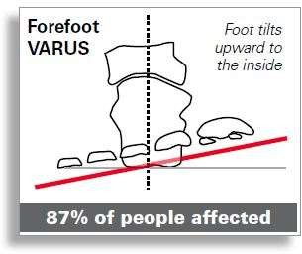
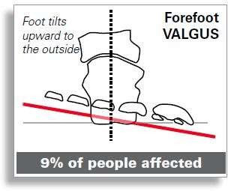
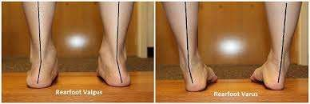
Observation- Deformities
Forefoot Varus
mid tarsal joint- Inversion
Subtalar joint- Neutral
Forefoot Valgus
mid tarsal joint- Eversion Subtalar joint- Neutral

Slide 16
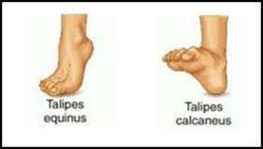
Observation- Deformities…
Talipes Eqinus
Plantar flexed foot
Can cause plantar fascitis, metatarsalgia

Slide 17
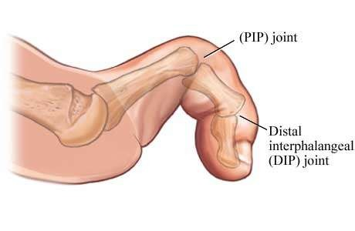
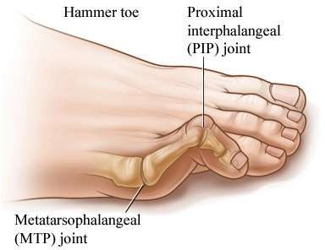
Observation- Deformities…
Claw Toes
MTP joint- Hyper Extension IP joint- Flexion
Hammer Toes
MTP- Hyperextended PIP- Flexed
DIP- Hyperextended

Slide 18
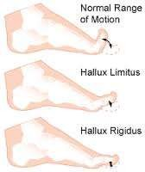
Observation- Deformities…
Hallux Rigidus
-Stiffness of Great toe at
MTP
- May be due to OA

Slide 19
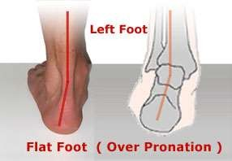
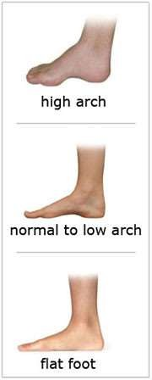
Observation –Deformities…

Slide 20
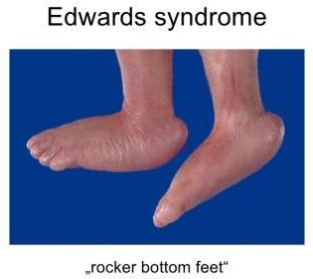
Observation –Deformities…
Splay foot
Spread of Metatarsal
Rocker Bottom Foot Forefoot in dorsiflexion Arch may be absent

Slide 21
Standing and Weight bearing: Anteropsterior view
Weight Bearing:
Equal on both feet and forefoot/hindfoot
Position of foot
Supination/pronation
Ask the Patient to walk on heel and toes:
Gives the idea about muscle power or functional range of motion
Does the patient use Cane or stick?
Use of cane on opposite side decrease the load on ankle by 1/3 of body weight

Slide 22
Standing and Weight bearing: Anteropsterior view
Check the toes
if parallel/ straight/
Spurs/ exostosis/Swelling
Check for tibia/ knee

Slide 23
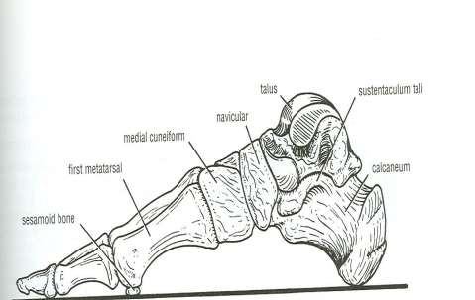
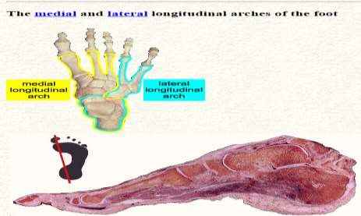
Standing and Weight bearing: Lateral view
Observe longitudnal arch of foot
Medial longitudnal arch should be higher than lateral

Slide 24
Standing and Weight bearing: Posterior view
Bulk of calf : compare on both sides
Achillis tendon : Vertical on both sides
Observe calcaneum for
shape position callosity
Position of malleolus

Slide 25
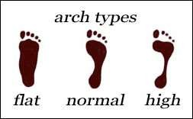
Foot Print Pattern
Light film of baby’s oil on patient foot and apply powder
Ask patient to step on piece of colored paper
Obsreve for pattern of foot

Slide 26
PALPATION
SURFACE ANATOMY IS THE KEY!!!
Palpate for
local rise of temperature Local tenderness
Palpation of specific areas-

Slide 27
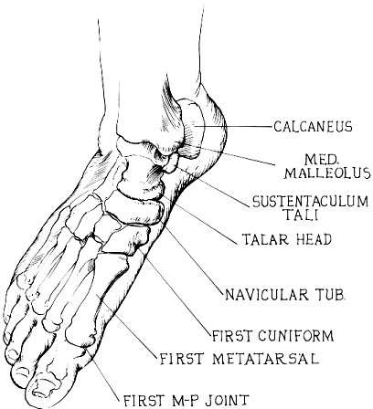
Palpation(Bony)…
Medial aspect

Slide 28
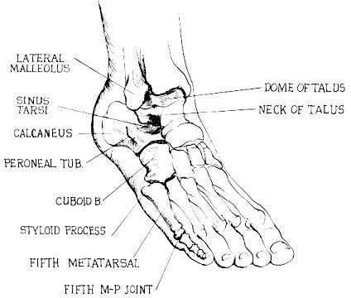
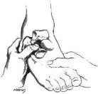
Palpation(Bony)…
Lateral Aspect

Slide 29
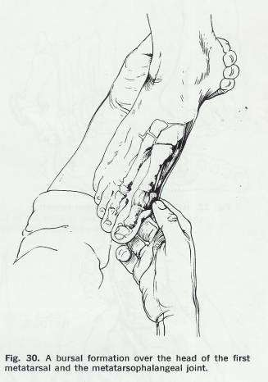
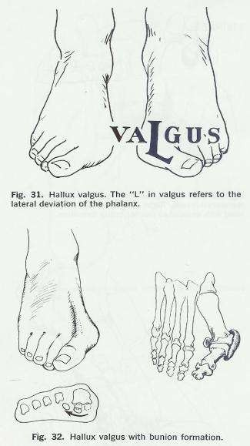
Palpation (soft tissue)…
Zone 1
Head of 1st MT bone
Patholology – gout, hallux valgus

Slide 30
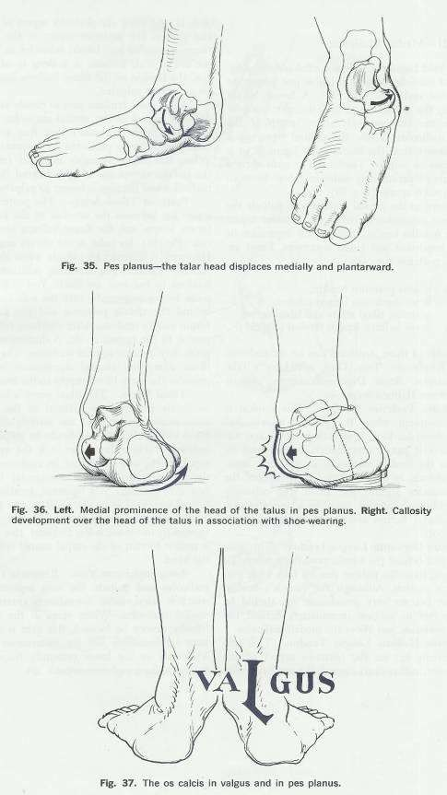
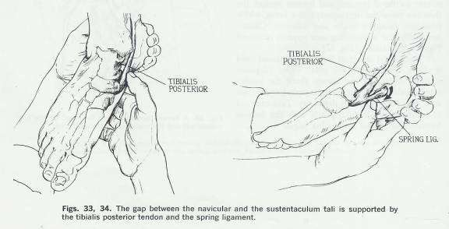
Palpation (soft tissue)…
Zone 2
Navicular tubercle and talar head

Slide 31
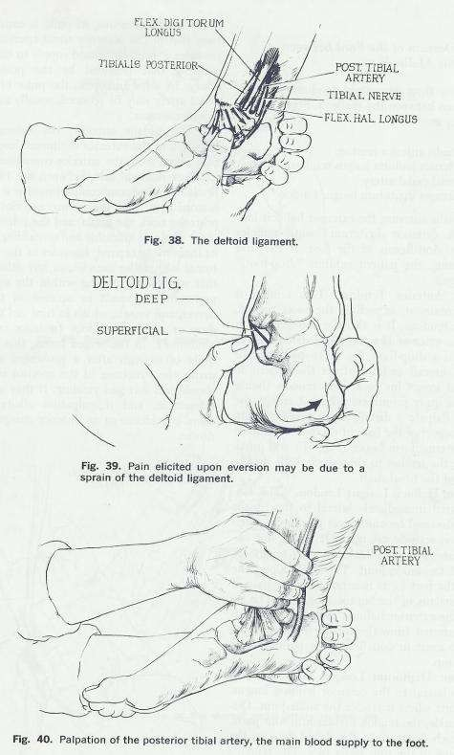
Palpation (soft tissue)…
Zone 3 - Medial malleolus
Palpate
- Deltoid ligament
palpate follwing structure in depression between posterior aspect of medial malleoli and achillis tendon
-Tibialis posterior tendon
-Flexor digitorum longus tendon;
- Posterior tibial artery and tibial
nerve;
-Flexor hallucis longus tendon

Slide 32
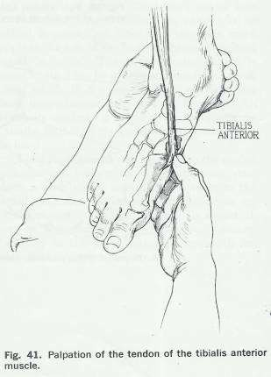
Palpation (soft tissue)…
Zone 4 - Dorsum of foot between malleoli
3 important tendons and one vessel that pass between the malleoli. From medial to lateral they are:
  Tibialis anterior tendon Extensor hallucis longus
tendon
  Dorsal pedal artery;
Extensor digitorum longus tendon
-Peroneus Tertiu

Slide 33
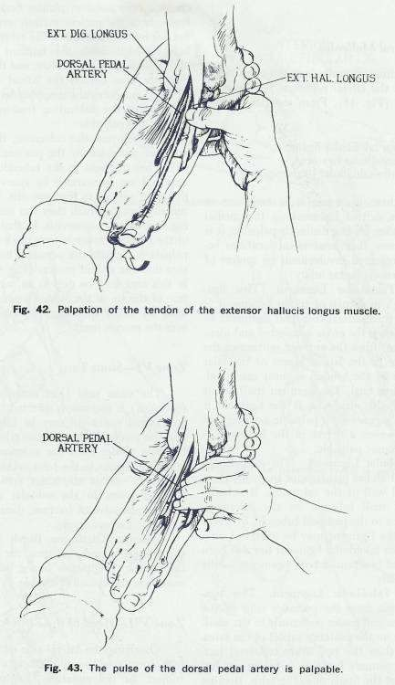
Zone 4 - Dorsum of foot
between malleoli…

Slide 34
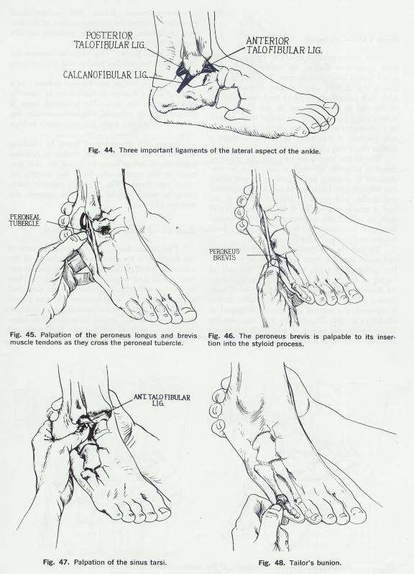
Palpation (soft tissue)…
Zone 5 – Lateral Malleoli
3 clinically important ligaments, which comprise the lateral collateral ligaments of the ankle joint . From anterior to posterior, they are:
-Anterior talofibular ligament
-Calcaneofibular ligament
-Posterior talofibular ligament
Zone 6 sinus tarsi
commonly involved in
ankle sprain
Zone 7 head of 5th MT
Tailors bunion

Slide 35
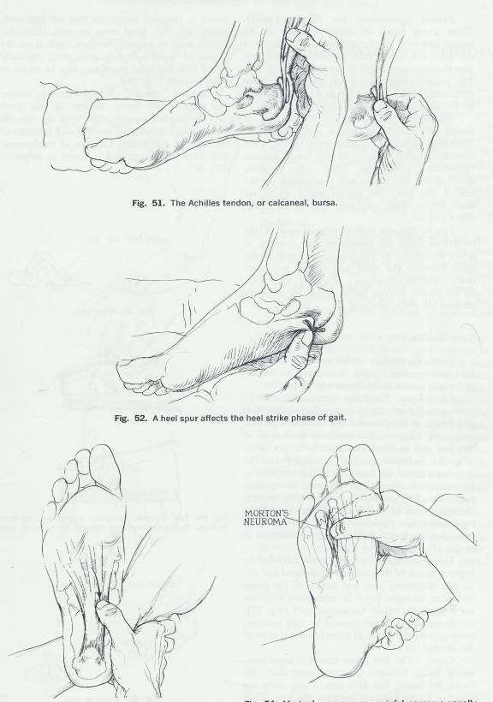
Palpation (soft tissue)…
Zone 8 Calcaneum
Retrocalcaneal bursa/ calcaneal bursa
Zone 9 plantar surface

Slide 36
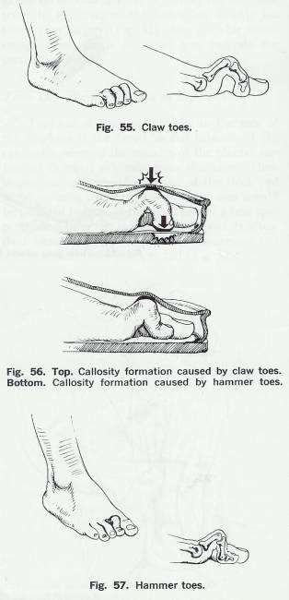
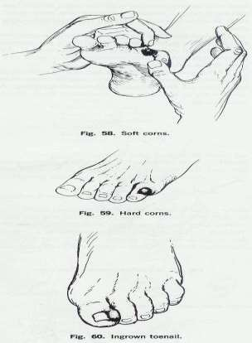
Palpation (soft tissue)…
Zone 10 toes

Slide 37
Range of Motion

Slide 38
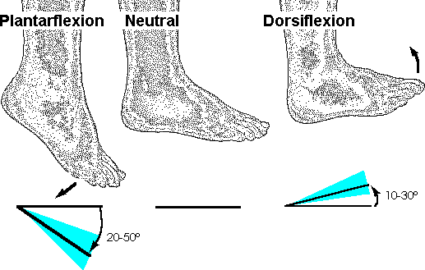
Range of Motion
Ankle motion
Check the range of motion
Dorsiflexion- 10 to 30
-Reduce the talonavicular joint
Plantar flexion – 20 to 50

Slide 39
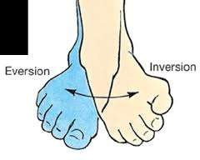
Range of Motion…
Hind foot – Inversion and Eversion
Patient sitting on stool with knee flexed at 70 degree
Hold ankle firmly from dorsum to fix talus by dosiflexion
Hold body of calcaneum in between thumb on one side and index and middle finger on other side with other hand
Turn in for inversion and turn out for eversion
I= 35 degree E= 25 degree

Slide 40
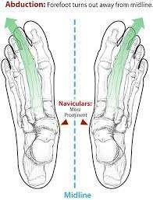
Range of Motion
Adduction and Abduction of Fore foot
Hold hind foot from dorsum with one hand
Hold forefoot with other hand
Passively deviate forefoot inward for adduction and outward for adduction

Slide 41
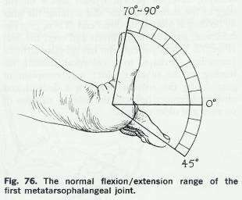
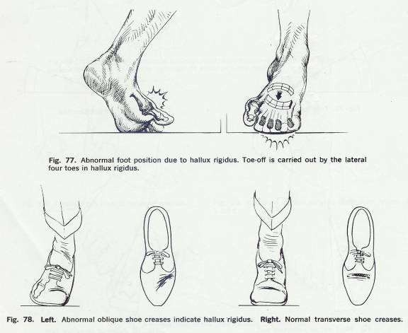
Range of Motion….
First MTP joint motion
Principally involved in toe off phase of gait
Stabilize foot and move great toe through flexion and extension

Slide 42
NEUROVASCULAR ASSESSMENT
Nerve Function
  motor
  Sensory
  Reflexes
Vascular Status
Distal pulses
Capillary refill

Slide 43
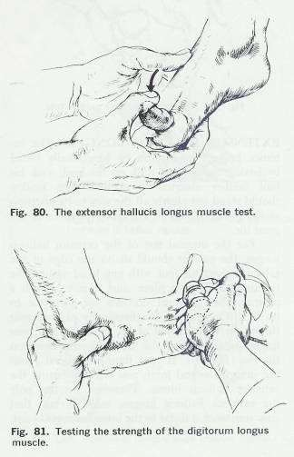
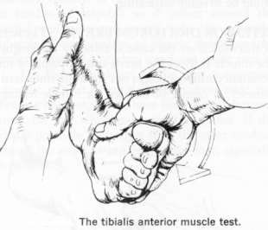
Neurological examination(Motor)…
Dorsiflexers
Tibialis Anterior
Deep Peroneal Nerve L4
Extensor Hallucis Longus L5
Extensor Digitorum Longus L5

Slide 44
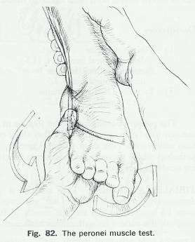
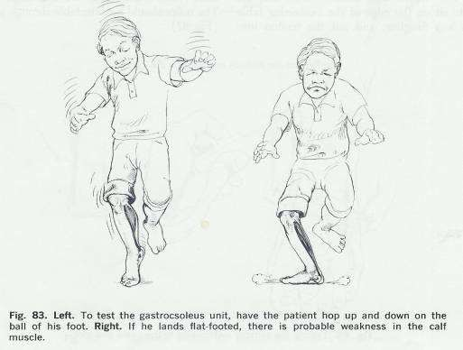
Neurological examination(Motor)…
Plantar Flexors
Peroneus Longus and Brevis
-Suprficial peroneal Nerve, S1
Gastrnemius and Soleus
- Tibial Nerve, S1 S2
Flexor Digitorum Longu
-Tibial Nerve L5
Tibialis Posterior
- Tibial Nerve L5
s

Slide 45
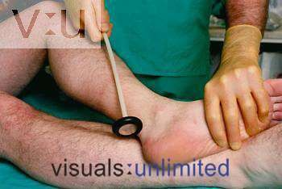
Neurological examination(Reflexes)…
Ankle Reflex, S1

Slide 46
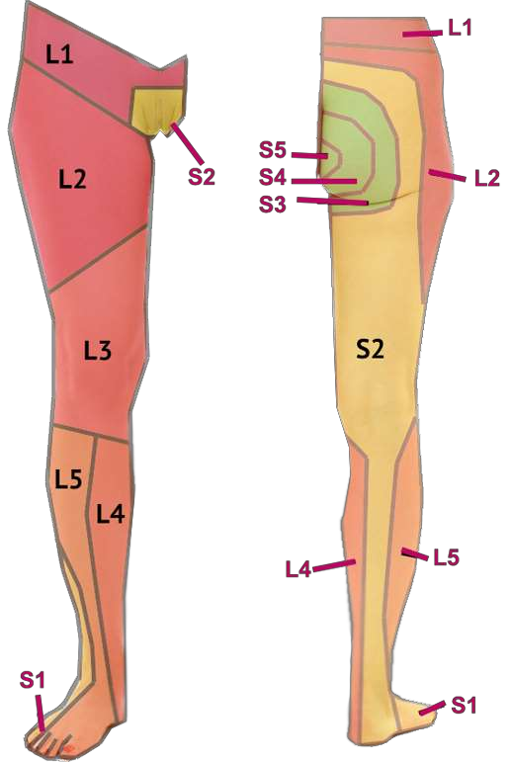
Neurological examination(Sensory)…

Slide 47
Special test

Slide 48
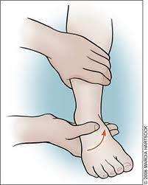
Stress test
For medial and lateral collateral ligament
Place the ankle in neutral
position
Hold the lower leg firmly from front by one hand
Hold the foot at about level of
talus by opposite hand
For testing the lateral collateral ligament , invert the foot and for testing of medial collateral ligament stress has to be given in opposite direction

Slide 49
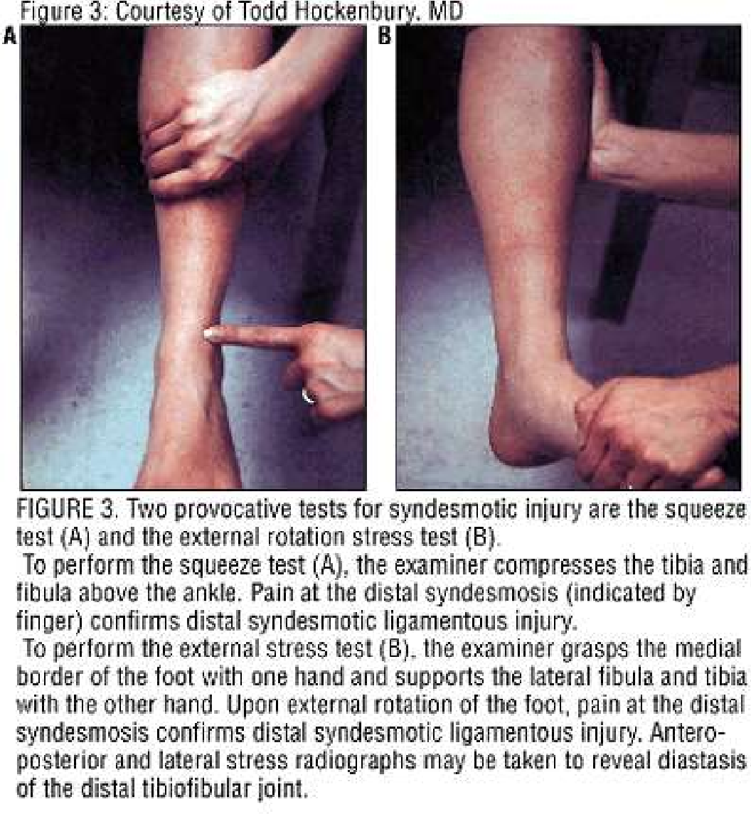
Evaluating for Syndesmotic injury
2 Tests for injury to th syndesmosis
  The Squeeze test
  External rotation test
e

Slide 50
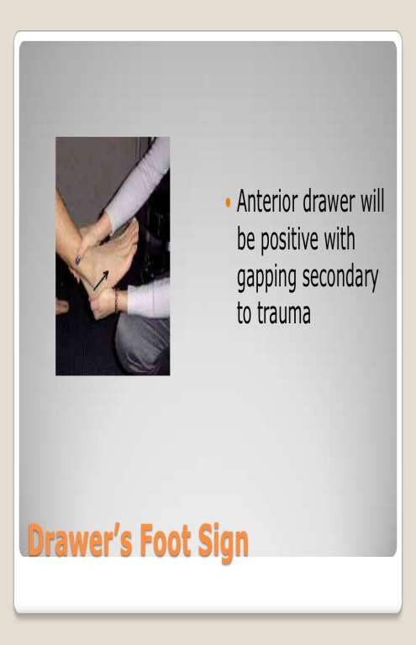
Anterior Drawer test
For integrity of capsule and anterior talofibular ligament
Pulling the heel anteromedially against resistance applied by the other hand over anterior aspect of lower leg
Anterior subluxation of 3 mm of talus is pathological

Slide 51
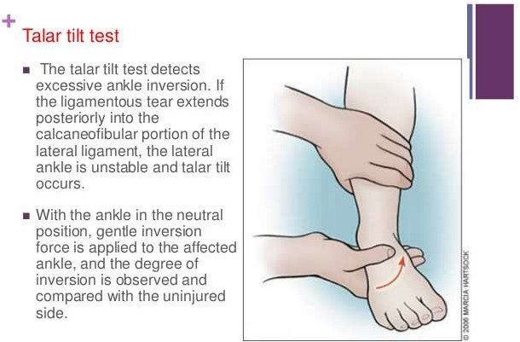

Slide 52
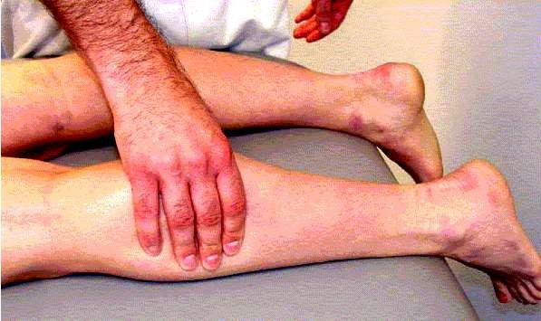
Test for rupture of tendo-Achilles
Thompson test
Prone position with feet projecting beyond examining table
Calf muscle squeezed
Normal or partially torn- planter flexion
Complete rupture- No movement of foot

Slide 53
Test for rupture of tendo-Achilles
Needle test
For integrity of distal 10 cm of tendo-achillles
Prone position
25 G hypodermic needle pierced through skin at 10 cm above upper end of calcaneum and just medial to midline of calf
Foot passively plantiflexed and dorsiflexed
Normal- needle swivel in direction opposite to movement of foot

Slide 54
Test for pre-achillles and post achilles pathologies
Pt asked to walk on toes with heel off the ground- pain in pre achilles pathology
Walk on heel- pain in post achilles pathology
Achilles tendinitis – pain in both mode of walking, more on walking on toes

Slide 55
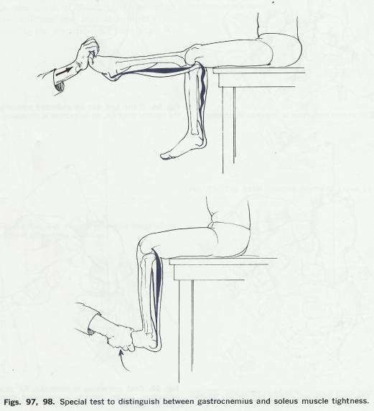
Ankle Dorsiflexion Test
To determine whether gastronimius or soleus causing limitation of ankle dorsiflexion
With flexion of the knee joint, ankle dorsiflexion achieved – Gastronemius
Not affected by flexion of knee- Soleus

Slide 56
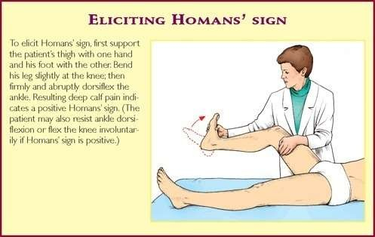
Homan’s sign
Test for deep vein thrombhophlebitis
Forcibly dorsiflex ankle with leg in extension
Pain in calf muscle

Slide 57
Measurement of equinus deformity
Position- lying on bed on lateral position
Passively dorsiflex as far as possible
Measure angle between long axis of leg and long axis of midfoot
Substract 90 from angle

Slide 58

Tibial Torsion Test
To determine whether toeing in is due to internal rotation of tibia
Normally a line drawn between malleoli is rotated is rotated externally 15 degree from a perpendicular line drawn from the tibial tubercle to ankle
In tibial torsion the malleolar line may face directly anterioly close to perpendicular line

Slide 59

Forefoot Adduction Correction Test
Forefoot adduction is common in children which may or may not need correction
If adduction can be corrected manually and abduction can be done beyond neutral position – NO TREATMENT
If only partially corrected to neutral or less than neutral – CAST CORRECTION

Slide 60

Colman Block test
coleman block test evaluates hindfoot flexibility and pronation of forefoot;
-
  initial deformity is in the forefoot followed by subsequent changes in the hindfoot
  test is performed by placing the patient's foot on wood block, 2.5 to 4 cm thick, with the heel and lateral border of foot on the block and bearing full
weight while the first, second, & 3rd metatarsals are allowed to hang freely into plantar flexion and pronation;
Interpretation:
  if heel varus corrects while the patient is standing on the block, hindfoot is considered flexible;
  if subtalar joint is supple & correct w/ block test, then surgical procedures may be directed to correcting forefoot pronation, which is usually due to plantar flexion of 1st metatarsal;
  if hindfoot is rigid, then surgical correction of both
forefoot & hindfoot are required

Slide 61
Examination of footwear
Distortion of shape- uderlying rigid defomity
Wrinkling of footwear- in persistent varus of heel, deep wrinkles on inner aspect of heel
Bulging out thinning
Deformity of sole

Slide 62

Last but not the least….
DON’T FORGET TO EXAMINE SPINE , HIP AND KNEE !!!!

Slide 63
Thank You

